Slide 2
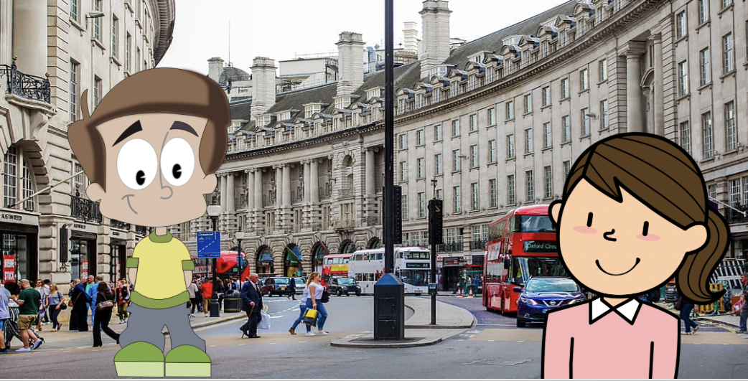
Hi! What’s your name?
Hello.

Slide 3
Nice to meet you Lillie. I’m Charlie. Where do you come from?
My name is Lillie. I’m ten years old..

Slide 4
I learn French at school!
I come from France, but I have just moved to London.

Slide 5
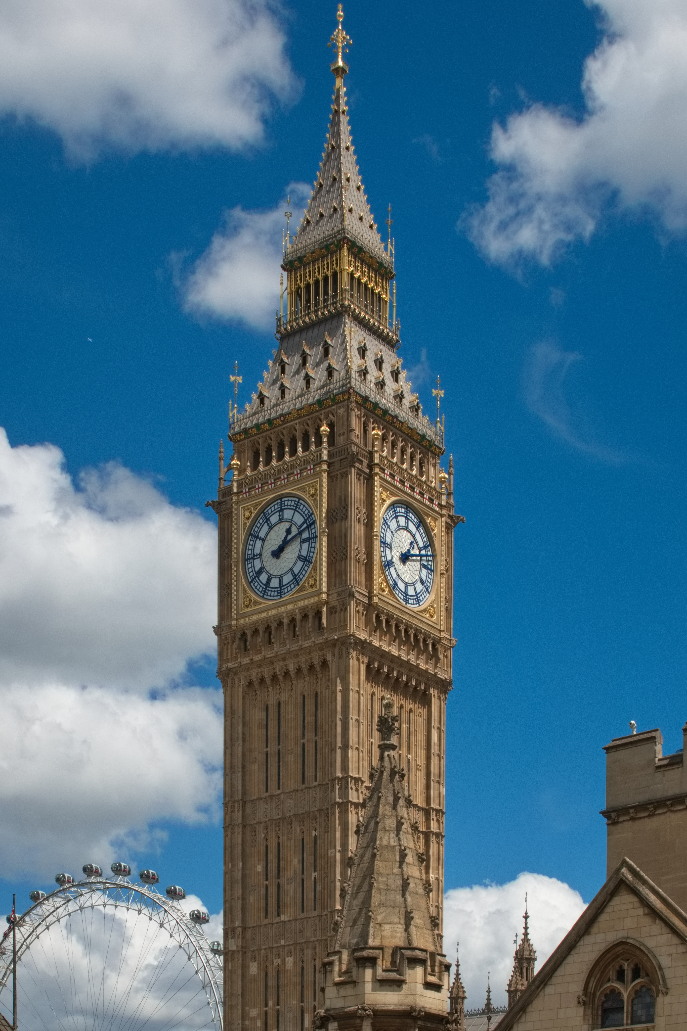
Have you seen Big Ben yet?
Yes I saw it last weekend!
That’s great!

Slide 6
What do you like to do in your free time Lillie?
I like going to the cinema and playing tennis.

Slide 7
Bye Lillie, see you soon.
Goodbye Charlie!
Come on Charlie, it’s time to go!

